Slide 1
Industrial Engineering
& Management lesson(6)

Slide 2
Charts for medium and large industry:
Organization charts for medium, and large industries are given hereunder. However these can vary from organization to organization depending upon the factors.
(a) For medium industry. For a medium size industry, a sample chart for management is given at following figure. Layout given in that figure is for a medium sized concern controlled by the board of directors, who act through a managing director. Here the activities of the concern are divided into various sections namely: sales, office, works, inspection and design, with a departmental head in each..

Slide 3
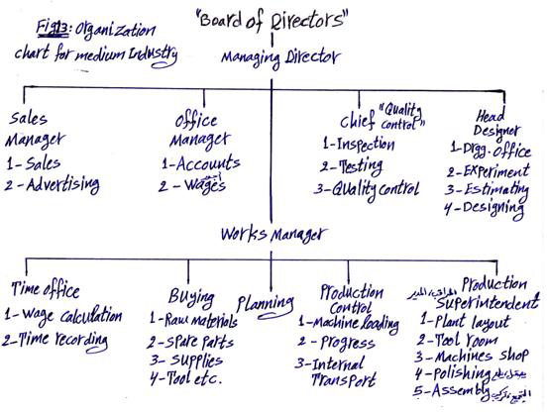
Fig : Organization chart of medium industry

Slide 4
This structure is designed to permit the managing director some help from over – work of his authority while still handling control.
In this manner, he is free from handling too much detail and from being brought into contact with large number of people.
Main works to be done in each department are given in the chart with the designation of the head..

Slide 5
(b) For large industry. A sample organization chart for a large concern is shown in the following figure. It may have necessary alterations to meet the requirements for a particular industry.
In this chart, the activities of the concern are divided into six main sections. Each having a head who is responsible to and is in direct contact with the managing director or general manager as the case may be.

Slide 6
Each sphere of the activity is fairly well designed and the risks of overlapping of activities are avoided. In very large organizations, there may be 2 or 3 sections under each general manager, who works under managing director.
None of the chief official is required to make contact with large number of people.
This does not mean that the heads are unapproachable.
What does it mean that they do not waste time asking number of persons for information

Slide 7
which they can get from the planned sources? The scheme is designed to make use of the skill and the time of the officials to the best advantages and to free them from handling a mass of details.

Slide 8
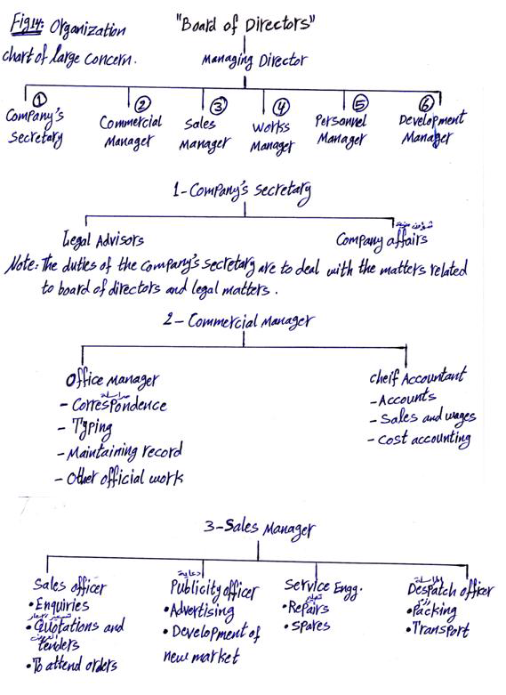

Slide 9
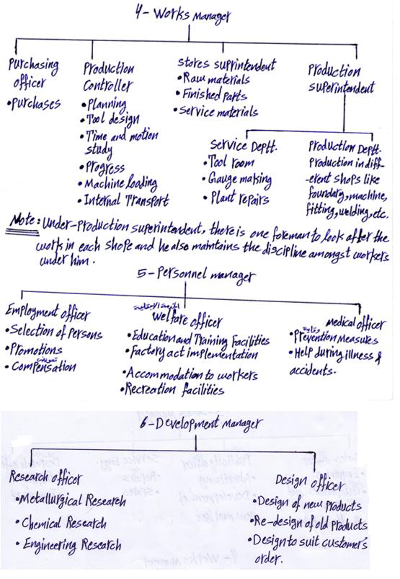
Fig 12: Organization chart of large concern

Slide 10
PROCESS ENGINEERING ECONOMICS
Economics is ever present in our lives because we earn money from our jobs and we spend money allocated by our personal budgets for housing, clothing, transportation, entertainment, etc. We spend money for these items based upon the perceived economic utility. Further, economics is the engine that drives industry.
Chemical engineers in the performance of their jobs will employ economics in the preparation of capital cost estimates, operating expense estimates, profitability analyses including the time value of money, feasibility studies, and to perform sensitivity and uncertainty analyses considering many alternatives. To move up the management ladder, they must have a working knowledge of balance sheets, income statements, and financial analyses of a corporate venture..

Slide 11
A business plan must be developed before any funds are sought for a new product or venture.
The capital budgeting function may be divided into several categories depending upon the time frame involved Strategic planning involves setting the goals, objectives, and broad business plans for a 5 to 10year time period in the future.. Tactical planning involves the detailing of the strategic planning for say 2–5 years in the future.
. Capital budgeting involves a request, analysis, and approval of expenditures for the coming year.
Business plans minimally consist of the following information along with a projected timetable:

